Slide 1

Olist Store Analysis
Presenter : Sakthi Muthukrishnan, Rutuja Zare, Smarak Nayak, M Gayatri, Akshaya Vadlakonda, Nasreldin Osman Haroun Ahmed.
Mentor: Bharat Gunda

Slide 2
INTRODUCTION
This project focuses on E-commerce Analysis, utilizing data to extract insights into customer behavior, sales performance, and market trends. Through this analysis, we aim to:-
Understand customer purchasing patterns.
Identify top-performing products and categories.
Analyze revenue trends and growth opportunities.
Improve business strategies through data-driven insights.

Slide 3
DATA OVERVIEW
Received dataset with 9 files with datatype CSV. These files has data regarding Product Category, Sellers, Products, Orders, reviews, Payments, items, locations and customers.
The data collection period is from 2016 till 2018
The data is not completely consistent had missing values, blank spaces which had to be cleaned prior analysis.

Slide 4
OBJECTIVE OF KPI
Weekday vs. Weekend Payment Statistics: The objective is to understand if there’s a pattern in customer behavior related to the time of week. Do customers tend to make more purchases on weekdays or weekends? This insight can help with targeted promotions and planning.
Number of Orders with Review Score 5 and Payment Type as Credit Card: This aims to identify if credit card users tend to leave higher ratings, which might indicate satisfaction levels and could inform customer engagement strategies.
Average Number of Days Taken for Order Delivery to Pet Shop Customers: The goal is to understand the average delivery performance. Is the shipping time meeting customer expectations, especially for pet shop customers who may need timely delivery for perishable items?
Average Price and Payment Value for Customers in Sao Paulo City: Understand the purchasing patterns of customers in a specific region to tailor marketing strategies or inventory planning.
Relationship Between Shipping Days and Review Scores: This seeks to evaluate whether faster delivery correlates with higher customer satisfaction, informing logistics improvements.

Slide 5
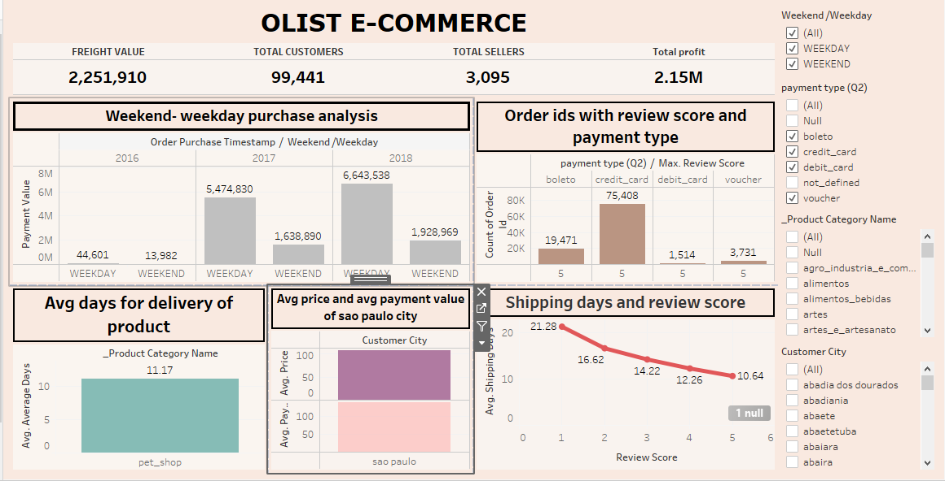
DASHBOARD

Slide 6
PROCESS
Data Cleaning and Merging : Handling missing values and outliers in Excel along with merging different sheets.
Data Analysis: Using Excel, Power BI and Tableau for visualizations and insights as per the KPI provided.
Techniques: Using calculations, filters and formulas for finding Weekend and Weekend analysis, for showing average number of days taken to deliver a product of a particular category, calculating average price and shipping days.

Slide 7
ANALYSIS
The Purchase is more during the weekdays which contributes to 77%
Review scores show that Credit Card users are more likely to leave high ratings.
The average shipping days is 11 days for pet shop orders.
Average price and payment value of customers of Sao Paulo is 108 and 139.7 respectively

Slide 8
RECOMMENDATIONS AND INSIGHTS
Based on the analysis, actionable steps that the business can take to improve operations or customer satisfaction.
Weekday vs. Weekend Trends: If more orders are placed on weekdays, suggest focusing marketing efforts and promotions around weekends.
Payment type : Credit cards are the most preferred payment method due to security and flexibility. Use targeted marketing to promote under used methods like boleto and voucher to attract a wider customer base.
Shipping Times: If delivery times are impacting satisfaction, shipping process, possibly by using faster carriers or improving inventory management for quicker fulfillment.
Shipping & Review Correlation: Recommend faster shipping for better customer satisfaction or addressing customer concerns about delivery delays.
-

Slide 9
CONCLUSION
Summary: Key finding highlight significant trends in weekend and weekday sales, credit card user engagement, regional difference in spending and the correlation between shipping speed and reviews.
Impact: By leveraging the insights the business can improve marketing strategies, customer engagement and operational efficiency .
Next step: Implement recommendation, monitor their impact and continue analyzing KPI to refine strategies.

